Slide 1
Capstone Project
Airbnb Booking Analysis Team Members Biswajit Paul Shreya Pattanayak
EDA

Slide 2
Contents
Introduction
Understanding Dataset
Data Wrangling
Data Cleaning
Main Objectives
Data Analysis And Data Visualisation
Conclusion

Slide 3

Introduction
Airbnb is an online marketplace connecting travellers with local hosts. On one side, the platform enables people to list their available space and earn extra income in the form of rent. On the other, Airbnb enables travellers to book unique homestays from local hosts, saving them money and giving them a chance to interact with locals. Catering to the on-demand travel industry, Airbnb is present in over 190 countries across the world.

Slide 4
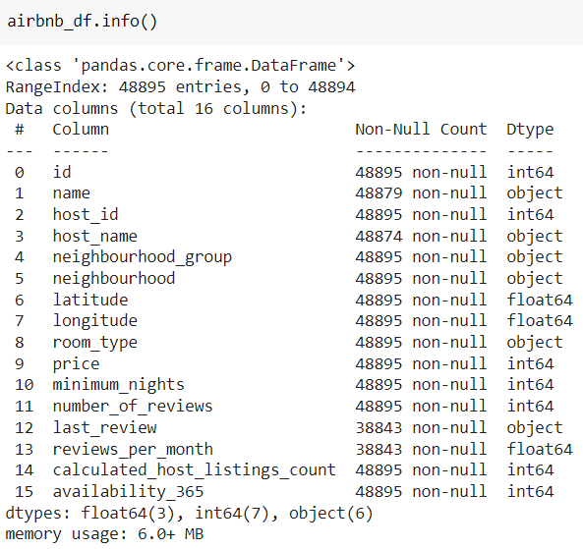
Dataset Overview
The given Airbnb dataset has total 16 columns.
There are total 48895 entries.
Data types are float64(3 columns),int64(7 columns) and
object(6 columns).
By analysing data’s and corresponding data types it is found
that all data’s are available in correct dtype except last review.
Last review should be in datetime format but we are not going
to use this column for our current EDA so lets leave it as object
dtype.

Slide 5
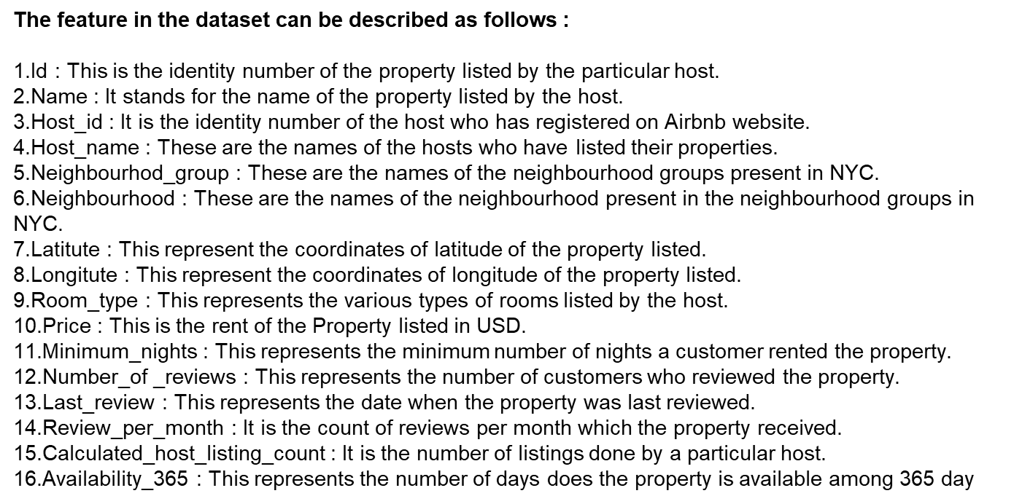
Feature Descriptions

Slide 6
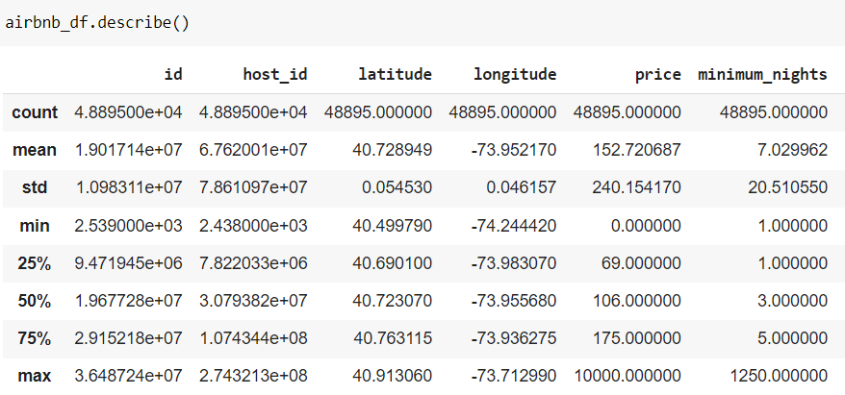
Dataset Overview(continue..)
Average price for the room is 152.7 $
On an average people stay 7 days in a room
Maximum price of the room is 10000 $
Mean review given to the room/apartment is 23.

Slide 7
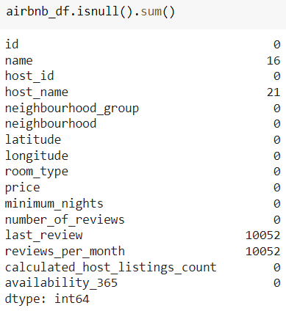
Data Wrangling
Name and host name has 12 null values
Last review and reviews per month has 10052 null values.
There we have total 4 columns with null values but "last_review" has no significance for this current EDA project. The missing values present in "reviews_per_month" can be replaced by 0.
Now lets take a look at "availability_365" column, there we can see even though availability is zero, there are some corresponding values available in "reviews_per_month" column .So that means that AirBnb reviewed some rooms having no guests yet. We can drop those values

Slide 8
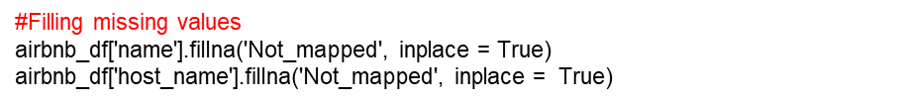
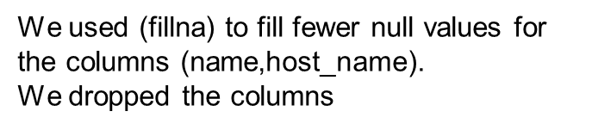

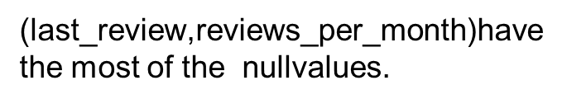
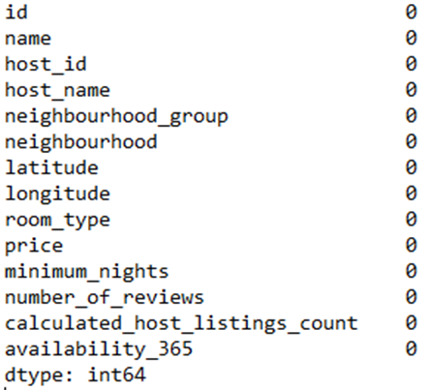
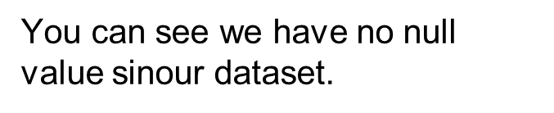
Data Cleaning

Slide 9
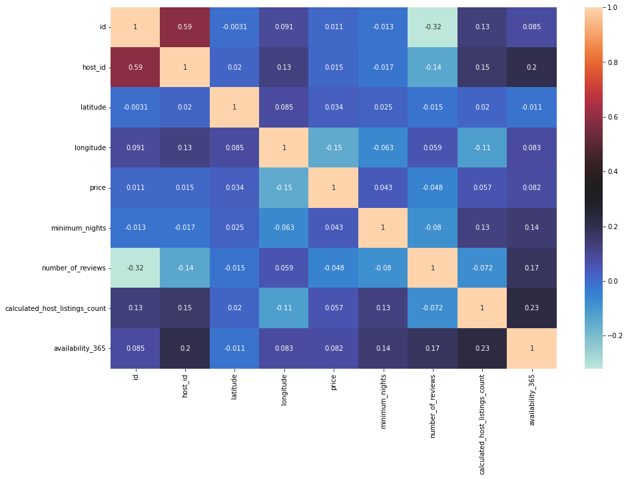
Viewing correlation of the numerical values

Slide 10
Main Objectives
What can we learn about different hosts and areas?
What can we learn from predictions? (ex: locations, prices, reviews, etc.)
Which hosts are the busiest and why?
Is there any noticeable difference of traffic among different areas and what could be the reason for it?

Slide 11
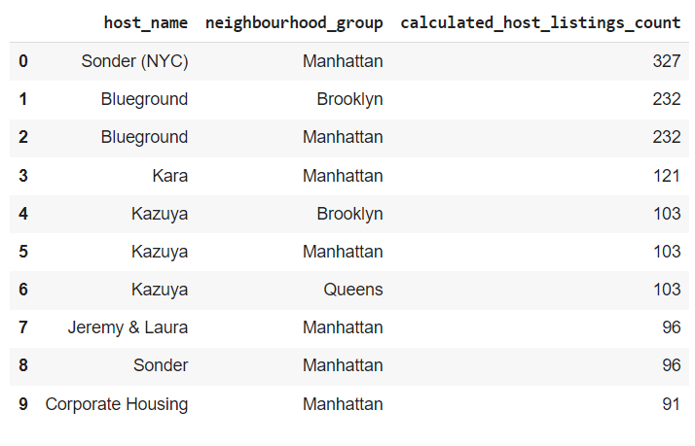
Data Analysis
hosts_areas =modified_df.groupby(['host_name','neighbourhood_group'])['calculated_host_listings_count'].max().reset_index()
hosts_areas.sort_values(by='calculated_host_listings_count', ascending=False).head(10)
From the top 10 observations according to highest calculated_host_listings_count, we can found that 7 results are from Manhattan area,2 from Brooklyn and 1 from Queens. So it is clear that AirBnb is a popular business model in Manhattan. The host who has most host_listings are sonder(NYC).

Slide 12
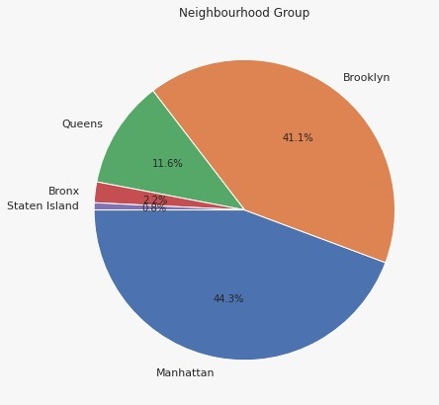
Data Analysis And Data Visualisation(cont..)
Manhattan has maximum host listings which is 41% of the entire listings, then Brooklyn has 37%,Queens has 16%,Bronx has 4% and at last Staten island has only 1% listings.

Slide 13
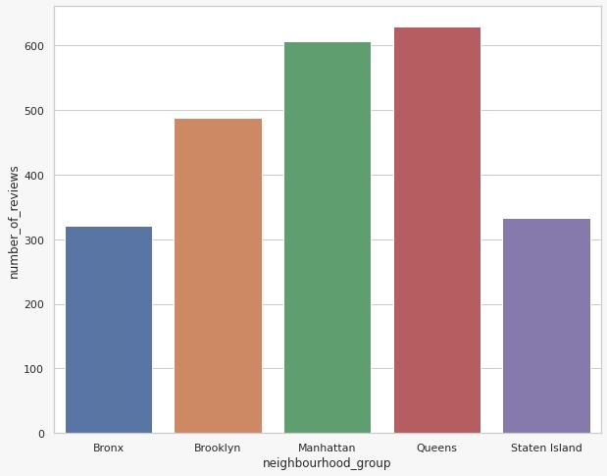
Data Analysis And Data Visualisation(cont..)
areas_reviews = modified_df.groupby(['neighbourhood_group'])
['number_of_reviews'].max().reset_index()
areas_reviews
From prediction Area vs number of reviews we can visualise thay Queens holds the maximum no. of reviews

Slide 14
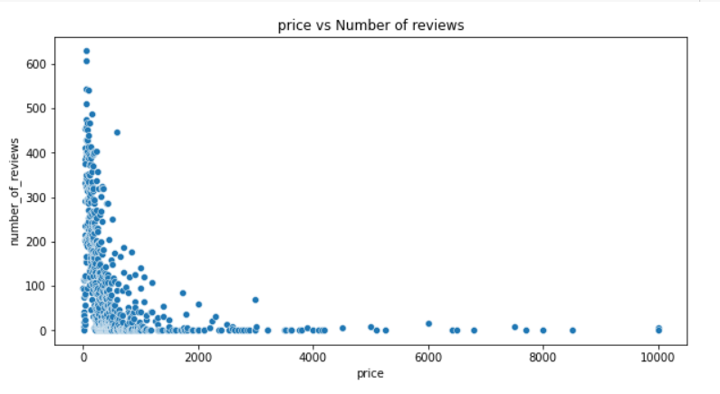
Data Analysis And Data Visualisation(cont..)
price_area = modified_df.groupby(['price'])['number_of_reviews'].max().reset_index()
price_area.head(5)
Number of reviews are more at low price and reviews decreasing when price increases.
From the scatterplot it is clear that
most number of people prefer budget friendly rooms.

Slide 15
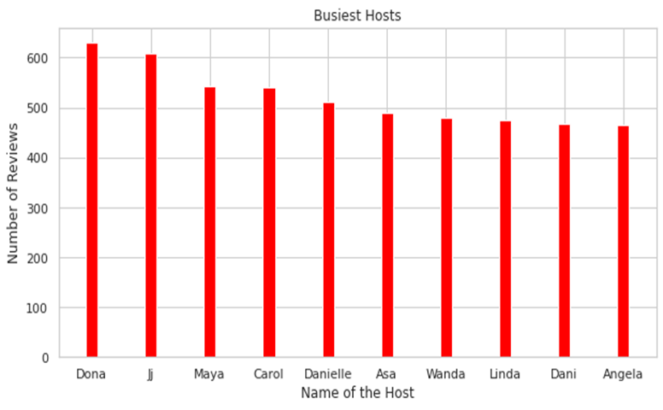
Data Analysis And Data Visualisation(cont..)
#Creating a Report on host name and reviews on it
busiest_hosts = modified_df.groupby(['host_name','host_id','room_type'])['number_of_reviews'].max().reset_index()
busiest_hosts = busiest_hosts.sort_values(by='number_of_reviews', ascending=False).head(10)
busiest_hosts
Busiest hosts are:
1. Dona
2. Ji
3. Maya
4. Carol
5. Danielle
Because these hosts listed room type as Entire home and Private room which is preferred by most number of people.

Slide 16
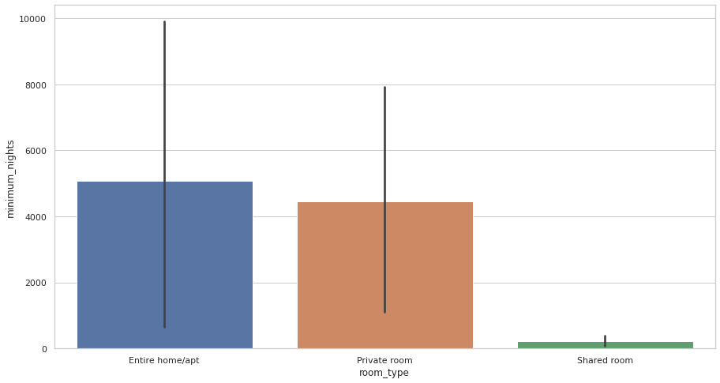
Data Visualisation
traffic_areas = modified_df.groupby(['neighbourhood_group','room_type'])['minimum_nights'].count().reset_index()
traffic_areas = traffic_areas.sort_values(by='minimum_nights', ascending=False)
traffic_areas
Shared rooms are very cheap as compared to Entire home/apt
Private rooms are little costlier than shared rooms
Entire home/apt is very expensive than all others.

Slide 17
Data Analysis
Even though shared rooms are much cheaper as compared to private rooms most reviews are for private rooms which means that most number of people prefer private rooms over other room type. Probably couples or small group of peoples who need more privacy and prefer budget friendly stay will go for private rooms, so we can say that most of the AirBnb customers are from this category.

Slide 18
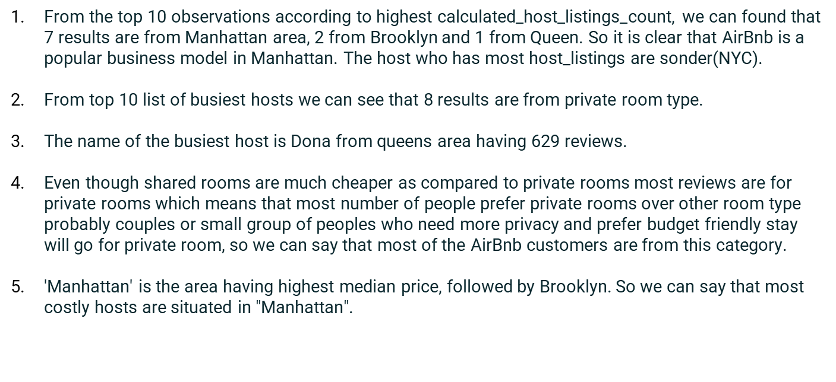
Key Findings

Slide 19
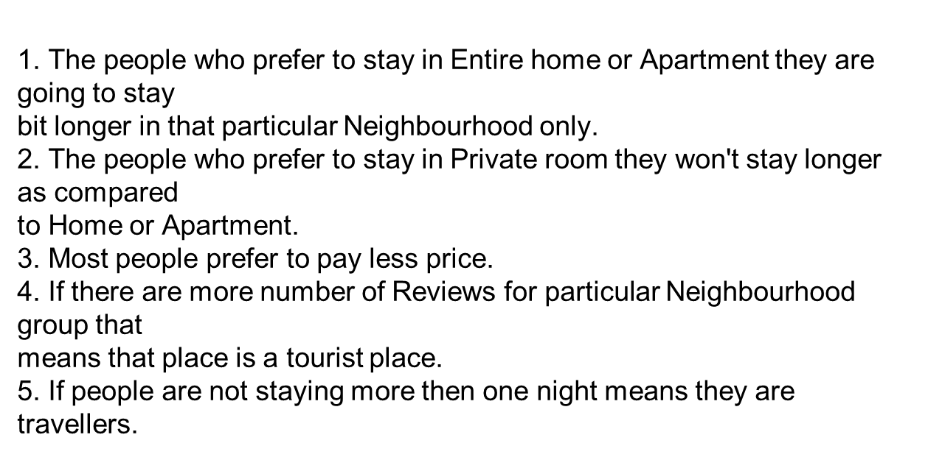
Conclusion

Slide 20
THANK YOU

